Slide 1
The digitalisation of work: Which way forward?
Jadranka Švarc, Ph.D.
Professor Marina Dabić , Ph.D.
Dubrovnik, May 17-20th 2021

Slide 2
Digital economy – changes in labour market
Rapid transformation of work
Content
(occupation, job tasks, professions)
Organization
(online platforms, algorithmic management, mobile)
Qualifications and salaries
(expertise, abstract know., creativity, polarisation in salaries)
Changes in the structure of the labour market

Slide 3
Purpose of research
There are serious socio-political theoretical controversies about the future of work
Serious socio-political controversies about the future of work
How digital technology influences contemporary work?
Are changes in work revolutionary?
Is digitalisation more formidable in relation to work than the first industrial revolution ?
There is no coherent theory or analytical-normative framework to assess the transformation of work under digital technologies
Purpose of research
To summarise main theoretical controversies regarding the digitalisation of work which might have practical implications for public and government policies to facilitate positive change with respect to the digital labour market

Slide 4
Methodology: conceptual research
To describe the three socio-technological megatrends that reorganise the economy and society on a global scale including work
To discusses two dominant narratives - utopian and dystopian - regarding the evolution of work driven by digital technologies over the
four selected areas which are rich in theoretical controversies
Technological change
Labour platforms
Polarisation of work
Non-standard employment
In order to identify future research themes that require critical thinking and provide practical implications for policies in labour market remediation

Slide 5
Global megatrends-driving forces behind changes in work
Globalisation of the labour market
Remote work and mobility of the workforce- opportunities of workers’ inclusion in global value chains;
Relocating industries and businesses to areas of higher profits (e.g., the Chinese shock);
Weakening of local labour markets: depression of job opportunities, wages, and stagnant business dynamics;
compete with global digital labour platforms (decline in wages, education…)
Rise of the intangible economy and Industry 4.0
New business model/paradigm shift in comp. organization that integrates the whole value chain by digital technologies;
Cyber-physical communication systems (smart machines)(it is not automatization)
Unknown complex and ambivalent socio-technical and cultural phenomenon
Rise of platform capitalism/society
Dominated by technological giants, “the big five” (Google, Facebook..)
New economic models and value chains grounded in network effects and platform structures;
Increases productivity, provide additional income; work flexibility;
Decomposition of work into gigs;
Destroy their competitors and entire industries;

Slide 6
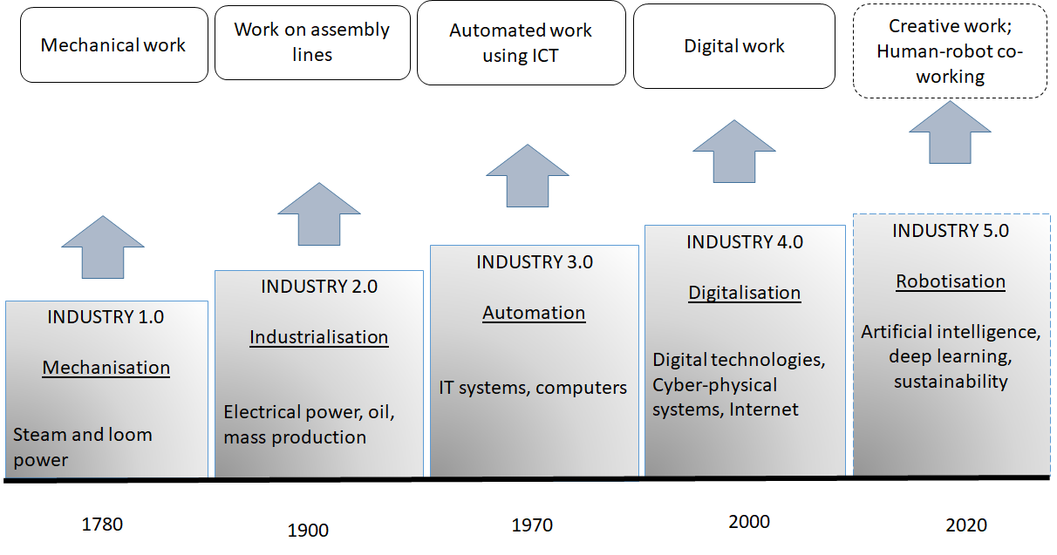
Development of work in the industrial age
Adapted from Buhr, 2015.

Slide 7
There is no consensus regarding the impact of the mega-trends on jobs and employment
Pessimists
Optimists
doomsday predictions for a dystopian future of work, painting a bleak picture of future job destruction, polarisation, and rising social inequalities
adopt a utopian perspective, boosting productivity, flexibility, creativity, abstract reasoning, and new, good-quality job opportunities
Call for analysis of:
Contrasting utopian and dystopian narratives, within the four selected controversial topics of work in the digital era that require critical theoretical analyses.

Slide 8
1.Technological change towards the digitalisation of work
Technological unemployment: an increase in technical efficiency above the level of labour absorption (compensation mechanism in transition from agrarian to an industrial society is not working);
Secular stagnation: today’s innovation, centered around entertainment (e.g., games and social networks), cannot contribute to long-erm economic growth;
Income gains reserved fpr only a small number of company owners (e.g., Google and Twitter);
Skyrocketing of wealth for the top 1% of capital owners (1% to 5% of the population);
A large number of jobs will be automated in the near future or may even disappear completely;
Negative impact on employment and wages
Pesimist
Enable “major restructuring”- new work skills and work organization, eventually enrich lives, businesses, and the world’s economy
Computers can improve our mental strength, just as the steam engine improved our muscle strength in the past and bring revolutionary changes comparable to the electrification of the late nineteenth century.
Digital technologies are fundamental optimisation factor that leads to zero marginal costs, free services, lower prices, increased productivity, and new job markets.
Empowerment of workers through a network of micro entrepreneurs against traditional corporations<;
wWde range of tasks are still difficult to automate because of the creative and social intelligence of people.
It is time to “kill” the myth of technological job loss, because history has shown that such anxieties never come to realization .
Optimist

Slide 9
2. Labour platforms
Make a new type of sociotechnical work system which disrupt established labour market through company concertation, network effects, and algorithmic management;
Decomposition or breakdown of human labour into components or micro-tasks (“gigs” or “rides”), such as coding, labelling, and describing items;
Disappearance of complex and professional work, skills, and expertise;
Alienation of work thorough Tayloristic fragmentation of work - gig work usually reduced to “slave clicking” wherein the worker is part of a distributed computer system and acts as a computer processor (Amazon Mechanical Turk (AMT); a labour platform launched in 2005 with over half a million "Turks" participating across 190 countries;
Low wages/pauperisation
Pesimist
Anyone connected to the Internet (smartphone, tablet, or computer) can earn a living by becoming an employee or subcontractor;
Workers can take different forms of flexible and freelance work, becoming self-employed micro-entrepreneurs or “molecular capitalists”. This can potentially be more prosperous than employment in traditional corporations with rigid regulations and hierarchies
It can be beneficial for low-income households (as they are no longer restricted to the local market) and can gain better pay rates on global platforms; and vulnerable working groups (disabled, older workers, uneducated, young, long-term unemployed, and migrants) as they lower the entry barriers to the labour market;
Algorithmic management liberates workers from rigid institutionalization of traditional work environments, tedious jobs, provide freedom, flexibility, creativity, and entrepreneurship.;
Optimist

Slide 10
3. Polarisation of work
Digitalisation favours higher levels of knowledge and analytical thinking, problem-solving capabilities, and abstract jobs, such as managerial, professional, and technical occupations, which are highly educated and well paid leading to polarisation between “lousy and lovely jobs”
Pesimist
Increasing polarisation among workers, social inequality, and the growth of precarious work;
Vanishing of middle working class - occupations whose jobs are subject to algorithmic processing and automatization (book-keeping, clerical work, and repetitive production tasks) – could be vulnerable to extinction or pushed towards unemployment, “lousy” platform work, or low-wage service employment;
Rise of social inequality since the number of jobs at the extreme poles - high and low paid jobs - will rise: a handful of billionaires - like Jeff Bezos ; and millions of households without income rise.
Technological evolution will dichotomise the work force into economic elites who handle ICT and economic losers who lack the skills needed to complement the work of computers; a tiny hyper-meritocracy of around 10–15% of workers will become wealthy and live fascinating lives, while the remaining 85–90% will experience slavish and insecure employment with stagnant or decreasing wages (Tyler Cowen, Average is Over)
Optimist
Digitalisation boosts competition between companies and workers and raises the level of education and wages, as has been the case with the introduction of every new technology across the last 30 years or so.
Disappearance of alienated, monotonous, and repetitive work and the rise of creative work;
Emergence of new mid-level jobs related to ICT, such as developers, coders, computer scientists, or logistic specialists (vs vanishing of middle class).

Slide 11
4. Non-standard employment
Typical models of non-standard forms of work are labour platforms, which not only challenge traditional business models, but also raise a number of ethical, legal, and regulatory controversies regarding work protection, as these categories were determined prior to the digital age
Pesimist
Platform work is mainly associated with poor working conditions, low wages, job insecurity, and civil exclusion;
Platform workers, who have lost their status as employees and have become a virtual community of partners, micro-entrepreneurs, and subcontractors, are left to manage their own social protection, unemployment, retirement pension, and occupational sickness provisions They become digital precariats.
Platforms largely escape taxation and the payment of social security contributions because of their multinational nature and difficulties when it comes to the taxation of the value they create;
There is the collapse of the legal status of workers and the erosion of labour rights.
Optimist
Digitalisation can put an end to employment but not to the work itself. In the context of new labour relations, it becomes pointless to talk about labour rights, employers, employees, permanent labour contracts, precarious work, or even the national unemployment rate.
Uber Agrees to Classify British Drivers as ‘Workers’ https://www.nytimes.com/2021/03/16/technology/uber-uk-drivers-worker-status.html
Couriers who worked for Uber Eats, Glovo, Just Eat and Deliveroo in Italy from 2017 to 2020 must now be treated as "coordinated and continuous workers,“ and should pay €733 million
https://www.politico.eu/article/italy-demands-733-million-euros-in-fines-from-food-delivery-platforms/

Slide 12
Conclusions
debates about the implications of digital technologies on work and employment remain ambivalent and unsettled and require better conceptualization
Themes under discussion | Positive narratives | Negative narratives | Future research themes | Practical implications
Technological change towards digitalisation of work | Boosting productivity; new, good quality job opportunities | Technological unemployment; job destruction; mass unemployment; income and social inequality | Sociology of innovation; Science and Technology Studies (STS); meaning of work | Assessing the impact of technological progress
Labour platforms | Additional income; easy labour market access; freelance, escapism from institutional rigidity; jobs for vulnerable groups | Alienation of work; “lousy jobs”, polarisation of work; non-standard employment | New work organisation, occupations, education, and skills | New forms of work management
Polarisation of work | Rising competition; upskilling and creative thinking; new mid-level jobs related to ICT | Deskilling; vanishing of mid –level jobs and middle class | Class identity and social stratification | Social protection of vulnerable groups, education policy
Non-standard employment | Flexibility; freedom; entrepreneurism | Poverty and precarity; deregulation of work, erosion of social protection; insecurity | Social inequality and inclusion | Labour market regulations

Slide 13
Thank you for your attention!
Jadranka Švarc
jadranka.svarc@pilar.hr
Marina Dabić
mdabic@net.efzg.hr; marina.dabic@ntu.ac.uk

